Slide 1
Thread scheduling
(thread contd..)

Slide 2
Scheduling of threads involves two boundary scheduling,
Scheduling of user level threads (ULT) to kernel level threads (KLT) via leight-weight process (LWP) by the application developer.
Scheduling of kernel level threads by the system scheduler to perform different os functions.

Slide 3
Leightweight Process (LWP) :
threads in the user space that acts as an interface for the ULT to access the CPU resources.
Thread library schedules which thread of a process to run on which LWP and how long.
Each LWP is attached to a separate kernel-level thread.

Slide 4
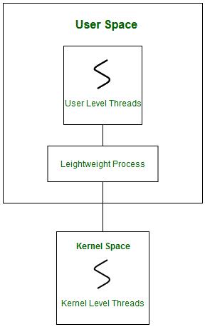

Slide 5
In real-time, thread scheduling requires two controls to be specified for the User level threads:
Contention scope, and
Allocation domain.

Slide 6
Contention Scope :
competition or fight among the User level threads to access the kernel resources.
this control defines the extent to which contention takes place.
defined by the application developer using the thread library.
Depending upon the extent of contention it is classified as:
Process Contention Scope and
System Contention Scope.

Slide 7
Process Contention Scope (PCS)
takes place among threads within a same process.
thread library schedules the high-prioritized PCS thread to access the resources via available LWPs
priority as specified by the application developer during thread creation

Slide 8
System Contention Scope (SCS)
takes place among all threads in the system.
every SCS thread is associated to each LWP by the thread library
are scheduled by the system scheduler to access the kernel resources.

Slide 9
In LINUX and UNIX operating systems, the POSIX Pthread library provides a function Pthread_attr_setscope to define the type of contention scope for a thread during its creation.
int Pthread_attr_setscope(pthread_attr_t *attr, int scope)
The first parameter denotes to which thread within the process the scope is defined. The second parameter defines the scope of contention for the thread pointed. It takes two values:
PTHREAD_SCOPE_SYSTEM
PTHREAD_SCOPE_PROCESS

Slide 10
Allocation Domain :
set of one or more resources for which a thread is competing.
there may be one or more allocation domains.
One ULT can be a part of one or more allocation domain.

Slide 11
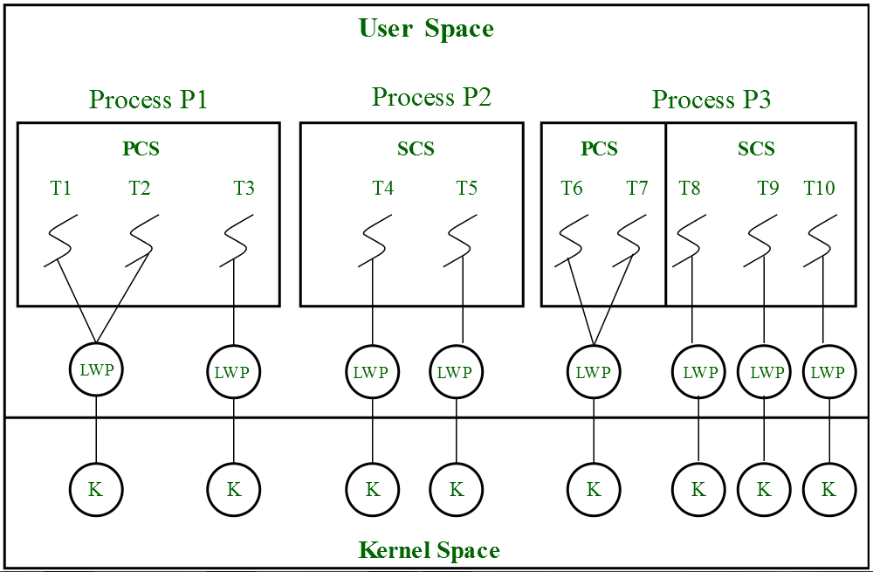

Slide 12
Note: For every system call to access the kernel resources, a Kernel Level thread is created and associated to separate LWP by the system scheduler.
Number of LWP for SCS = Number of SCS threads→ 5
Number of LWP for PCS = Depends on application developer →3
Number of Kernel Level Threads = Total Number of LWP → 8
Total Number of LWP = Number of LWP for SCS + Number of LWP for PCS→ 8(5+3)

Slide 13
Advantages of PCS over SCS :
If all threads are PCS, then context switching, synchronization, scheduling everything takes place within the userspace, reduces system calls and achieves better performance.
PCS is cheaper than SCS.
PCS threads share one or more available LWPs. For every SCS thread, a separate LWP is associated, for every system call, a separate KLT is created.

Slide 14
The number of KLT and LWPs created highly depends on the number of SCS threads created. This increases the kernel complexity of handling scheduling and synchronization. Thereby, results in a limitation over SCS thread creation, stating that, the number of SCS threads to be smaller than the number of PCS threads.
If the system has more than one allocation domain, then scheduling and synchronization of resources becomes more tedious. Issues arise when an SCS thread is a part of more than one allocation domain, the system has to handle n number of interfaces.

Slide 15
The boundary of thread scheduling involves CPU scheduling by the system scheduler.
The scheduler considers each kernel-level thread as a separate process and provides access to the kernel resources.

